Slide 1
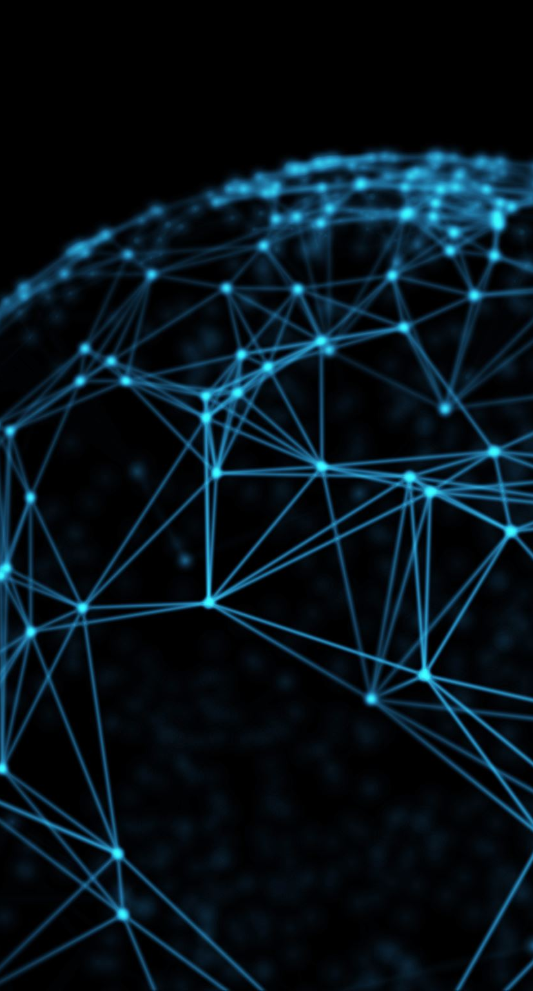
AstroNet: When Astrocyte Meets Artificial Neural Network
Authors: Mengqiao Han, Liyuan Pan, Xiabi Liu
Affiliation: Beijing Institute of Technology
Conference: CVPR 2023
Presentation video
Presented by : Aravind Dulipudi

Slide 2
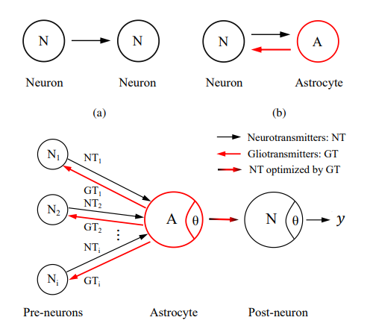
Abstract
Novel approach integrating astrocytes in neural networks
Aim: Enhance accuracy and efficiency in network structure optimization

Slide 3
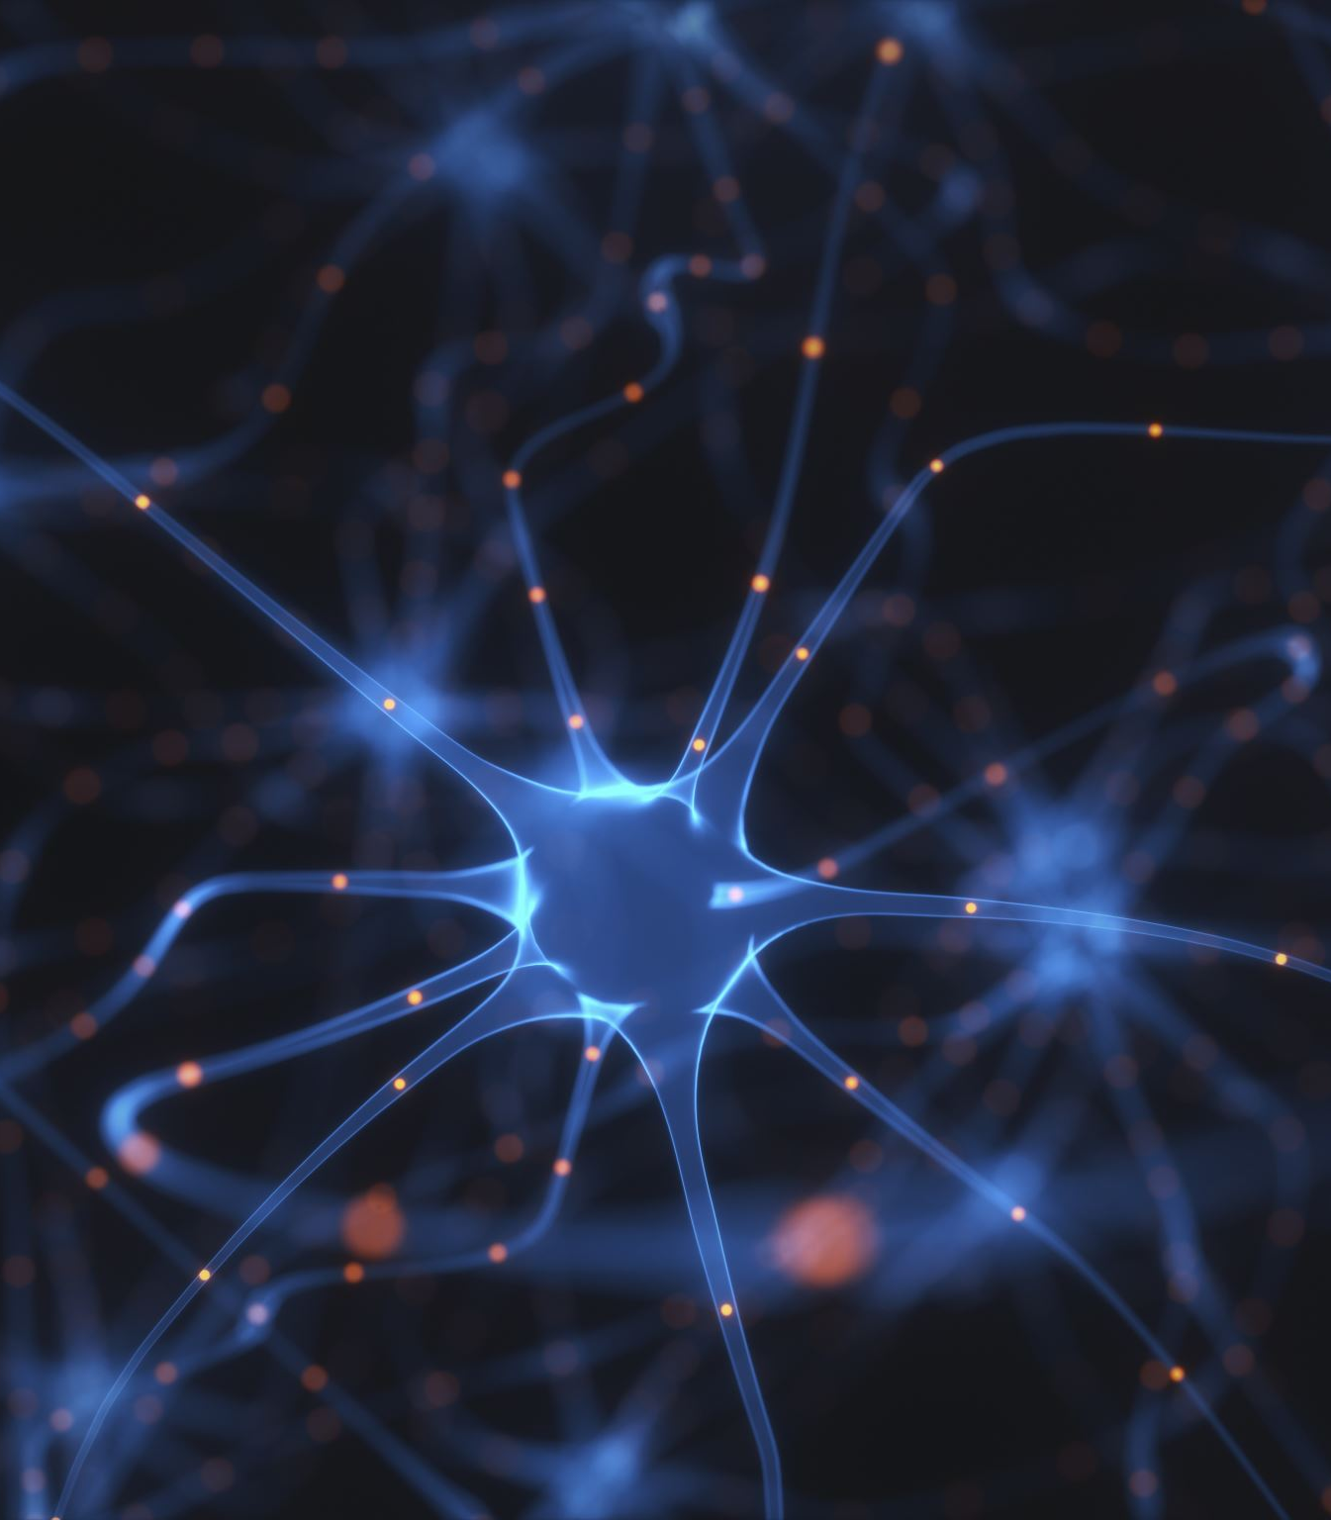
Introduction
Challenges in neural network structure learning
Potential of astrocytes in neural regulation
Novelty in applying biological concepts to AI

Slide 4

Main Objectives
Propose AstroNet model
Achieve adaptive network structure optimization
Enhance accuracy and efficiency

Slide 5
Key Contributions
Integration of astrocytes in the M-P neuron model
Development of the Astrocyte-Neuron model
Efficient neural network optimization

Slide 6
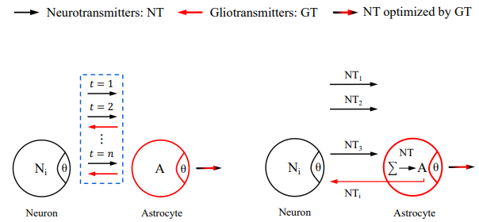
Methods
Astrocyte-Neuron model explanation
Temporal regulation mechanism
Global connection mechanism

Slide 7
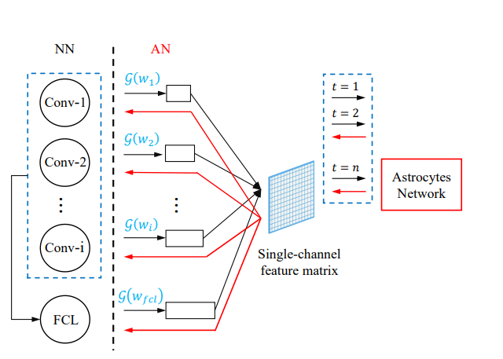
Architecture of AstroNet

Slide 8

Experimental Results
Results on ImageNet, CIFAR, MNIST
Superior performance in accuracy and efficiency
Comparison with state-of-the-art methods

Slide 9

Conclusion
Results on ImageNet, CIFAR, MNIST
Superior performance in accuracy and efficiency
Comparison with state-of-the-art methods

Slide 10
Key References
Jose M Alvarez and Mathieu Salzmann. "Compression-aware training of deep networks." Advances in neural information processing systems, 2017.
Gabriel Bender, Pieter-Jan Kindermans, Barret Zoph, Vijay Vasudevan, and Quoc Le. "Understanding and simplifying one-shot architecture search." International conference on machine learning, PMLR, 2018.
Han Cai, Ligeng Zhu, and Song Han. "Proxylessnas: Direct neural architecture search on target task and hardware." arXiv preprint, 2018.
Jia Deng, Wei Dong, Richard Socher, Li-Jia Li, Kai Li, and Li Fei-Fei. "Imagenet: A large-scale hierarchical image database." IEEE conference on computer vision and pattern recognition, IEEE, 2009.
Li Deng. "The mnist database of handwritten digit images for machine learning research [best of the web]." IEEE Signal Processing Magazine, 2012.

Slide 11
Acknowledgments
Supported in part by the National Natural Science Foundation of China [grant number 82171965]
Liyuan Pan’s work supported by the Beijing Institute of Technology Research Fund Program for Young Scholars

Slide 12

Thank you!

